Slide 1
How to Improve Energy Predictions?
4th December 2012 Andrew Tindal, SVP Head of Energy

Slide 2
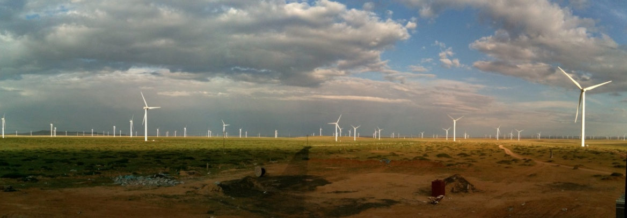
Why do we need to improve?
For wind to compete in the global energy market we need trust
Trust from Developers / Owners to take projects forward
Trust from Financiers to put money into wind projects
Wind already has the challenge of wind variability to deal with
This has the potential to give Owners / Financiers surprises
Need to reduce other potential sources of surprises
Power curves are a potential source of surprises
There are complex technical issues to deal with
Unlike wind variability the issues are under the control of our industry

Slide 3

What about warranties?
Focus of this presentation is how we can improve predictions
It would be naive to ignore the fact that power curves are subject to warranty arrangements – but these are commercial arrangements – and are outside the direct scope of this presentation
To make progress need to consider how predictions can be improved by better modelling the science of what is going on

Slide 4
The current power curve model
Input
Output
Site wind conditions
Power curve
Energy prediction
Current power curve variables:
Wind speed
Air density

Slide 5
In reality the situation is more complex – core issues
Input
Output
Site wind conditions
Power curve
Energy prediction
Additional power curve variables
Wind speed
Air density
Turbulence
Wind shear
Inflow angle
Anemometer characteristics
These parameters vary with effects of terrain, roughness, atmospheric conditions and wakes of other turbines
Site measurements may use different sensors from sensors assumed for sales power curve

Slide 6
There are other issues which impact power performance
Input
Output
Site wind conditions
Power curve
Energy prediction
Power curve – additional issues which impact energy prediction
Blade issues
Fouling
Icing
Surface degradation
Curtailment
Loads
Power
Environmental
Hysteresis algorithms
Cut in parameters
Cut out parameters
Sub-optimal performance
Sensor issues
Software issues
Other issues

Slide 7
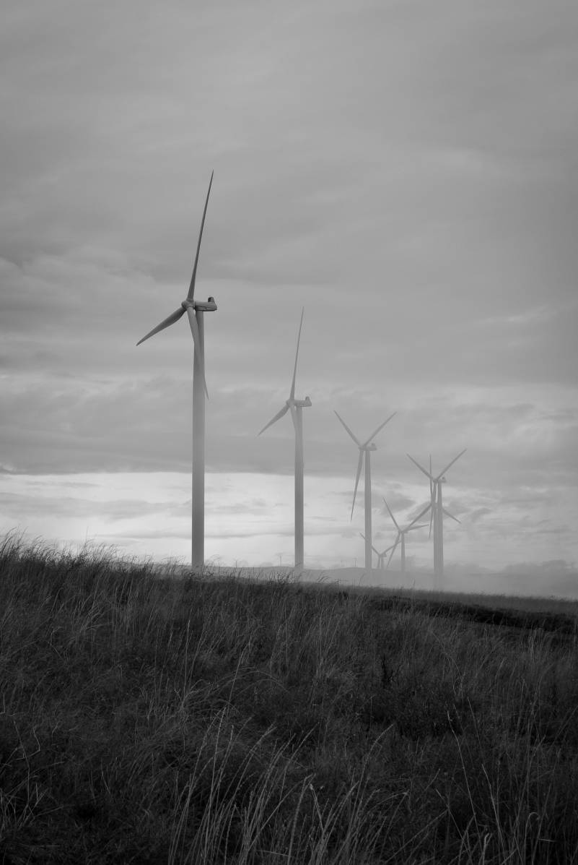
What would help improve predictions?
Theme 1 – Definition of the problem
Agreement of the variables to which a power curve is sensitive

Slide 8

What would help improve predictions?
Theme 2 – A clear starting point
A specific definition of the conditions for which a sales power is representative
Improved knowledge of the information used to define the sales power curve

Slide 9
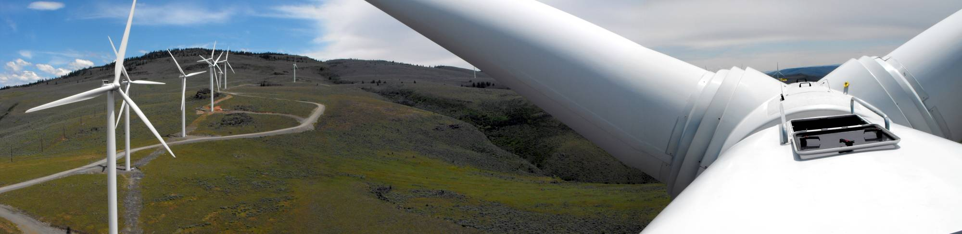
What would help improve predictions?
Theme 3 – Improved models and measurements
Improved models to allow power curves to be adjusted on a site specific basis for all variables to which a power curve is sensitive
Changing site specific measurement campaigns to provide better data as inputs to power curve adjustment models

Slide 10

What would help improve predictions?
Theme 4 – Information to improve models for “additional issues”
Improved information exchange to better model:
Curtailment
Hysteresis algorithms
Blade issues
Sub-optimal performance

Slide 11
Questions? Discussion to be continued in afternoon

